Slide 1
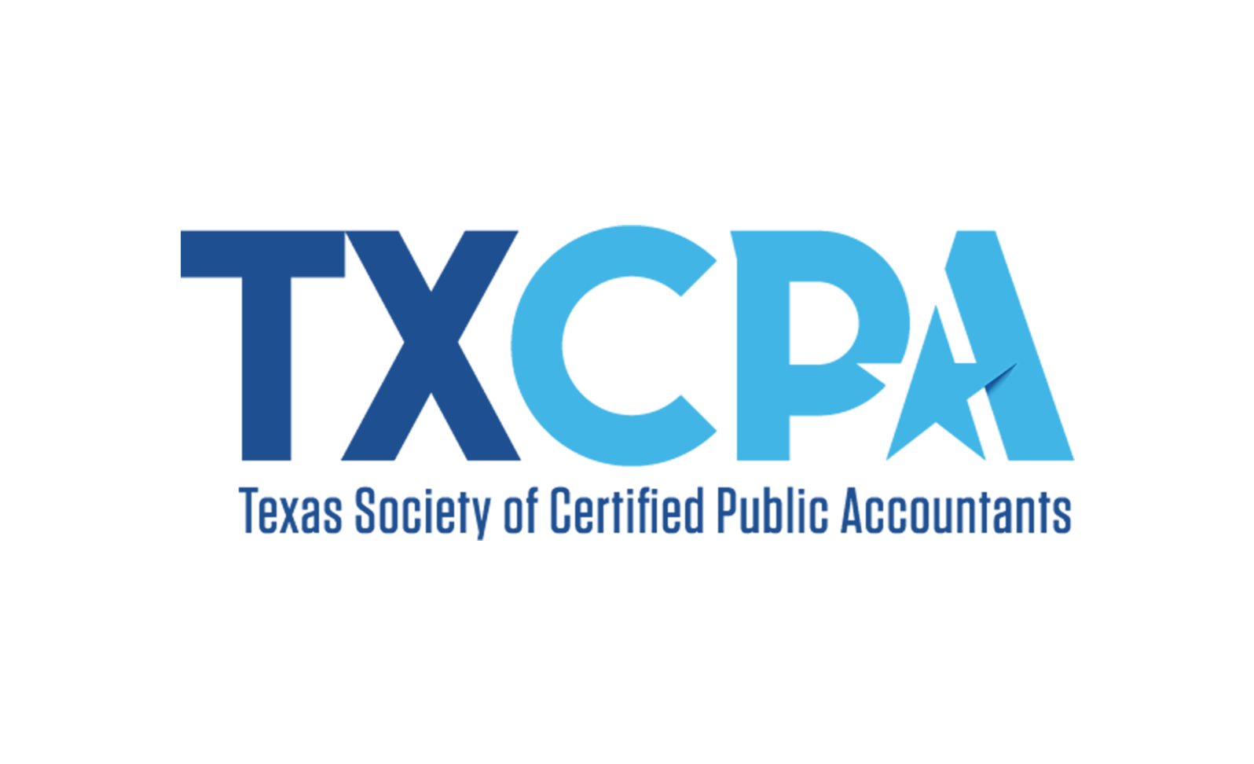
CPA: ENDLESS OPPORTUNITIES
Speaker Name | Title
Presentation Location
Presentation Date
Notes:
Good morning/afternoon everyone,
Today’s a good day because I get to tell you more about the profession I know and love, the endless opportunities that await for you as a CPA and what it takes to get there.
First, let me tell you a little about my CPA journey. My name is [insert name] and I am a [position/title] at [firm/organization]. It wasn’t too long ago that I was sitting where you are now trying to soak up as much as possible about my future and what I could do to ensure career success. My hope is that telling you a bit more about how I got to where I am and some specifics about certification will help you to greater success as a Future CPA (fingers crossed)!
Possibilities for telling your journey:
Why you decided to become a CPA.
Where did you go to school?
How/when did you take the exam? Did you pass/fail?
Words of wisdom you received or learned that could help them through the journey.

Slide 2
WHO IS TXCPA?
Notes:
Before I get into the details of all things CPA, let’s talk quickly about TXCPA. Consider TXCPA your professional home now and as you move through your career. We are your biggest fans and career advocates every step of the way.
TXCPA is a membership community of 28,000 working together every day to protect and promote the credential you’re working so hard to earn.
We’re here to support our members as they support their clients and employers.
And, most importantly, we’re behind our members advocating on their behalf.
Doing this together as a community of 28,000 has far greater results than we can achieve on our own as individual Texas CPAs.
We have a rich 100+ year history, and we are focused on a bright future.
The students here represent that future, and we want you to know how much we support you and want you to succeed.

Slide 3
WELCOME & ABOUT ME
Name
Organization
Job Title
When/How You Decided to Become a CPA
Notes:
Talk about yourself and your background here. Feel free to add more slides, photos, information, etc. This is where you tell your personal career story and what led you to become a CPA!

Slide 4
Notes:
If you haven’t decided to go all the way to become a CPA, what I am about to share may change your mind!

Slide 5
ACCOUNTANT VS. CPA: WHAT’S THE DIFFERENCE?
Notes:
All CPAs are accountants by training, but not all accountants are CPAs. These are some of the ways CPAs stand out and are positioned to be trusted advisors.
- We have an education, work experience and ethics requirement.
- We pass an exam to certify our knowledge and expertise.
- We are licensed by a state board and follow important guidelines to ensure the public is protected.
- We have a higher earning potential than non-CPAs and are in high demand with greater job security.
- And a CPA can take their license and knowledge and work in any organization, or even start their own firm or small business.

Slide 6
EMPLOYMENT OPTIONS
Notes:
The CPA opens doors to a variety of career options that are listed on this slide.
Tax and Financial Planning
CPAs help businesses and individuals by recommending savings, investment and tax options. These CPAs also help with international business laws and transactions.
Business and Industry
CPAs working inside companies manage financial records, develop business strategies and secure financing for major projects. CPAs are a critical part of a company’s management team, often overseeing the finances of the entire company and its profits.
Forensic Accounting
CPAs in forensic accounting track down fraud, white-collar business crime and insider trading. Through their information-gathering and accounting background, CPAs assist in determining an individual’s guilt or innocence.
Information Technology and Consulting
CPAs help many businesses design and implement their computer systems, software applications and network security. They may also give advice on issues affecting employees, such as retirement plans – or issues that affect the company, such as purchasing a new building or property.
Education
CPAs prepare the next generation of accountants at the high school and college levels. They use their knowledge of the accounting profession to teach basic accounting, auditing and taxation.
Government
CPAs manage governmental finance, examine individual and corporate tax returns, investigate fraud and evaluate the use of tax dollars for government programs. CPAs in government can work for the Internal Revenue Service (IRS), the FBI or any number of public agencies.
Public Accounting
CPAs in public accounting review the financial records of companies for accuracy and accountability. Companies that are publicly traded on the stock market must have their records approved and certified by a CPA every year.
Your own company – work for yourself!
Start your own business with the knowledge you gain along the path to licensure.
Long story short, career options as a CPA are many and far, and the impact you are able to make in your community, individually and for your organization is far reaching.

Slide 7
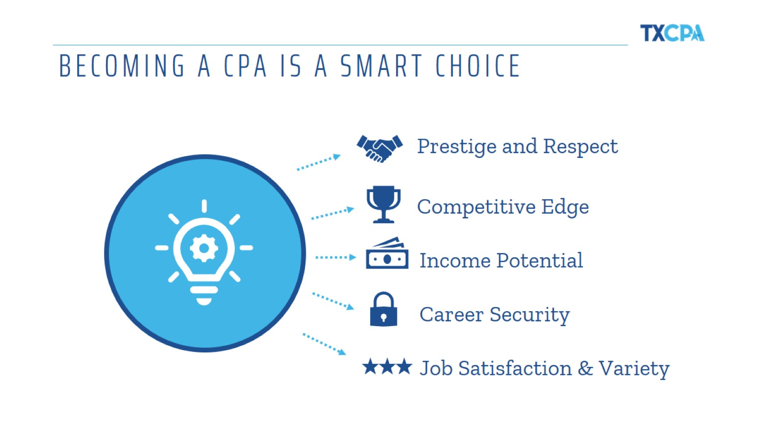
BECOMING A CPA IS A SMART CHOICE
Notes:
I will review the 5 main reasons you should consider becoming a CPA in more detail!

Slide 8
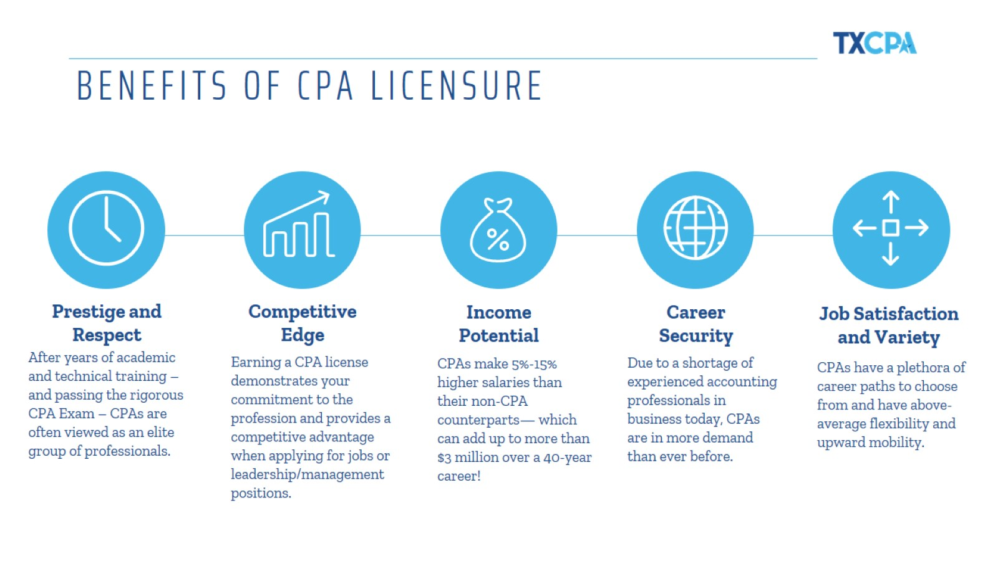
BENEFITS OF CPA LICENSURE

Slide 9
STRENGTH OF THE CPA CREDENTIAL
Notes:
Adding the credential to your accounting education improves your job prospects.
And according to the Department of Labor, there is anticipated growth in employment opportunities over the next several years.
As you can see, adding those three letters makes you even more attractive as a new hire.

Slide 10
THE WORLD NEEDS SKILLED ACCOUNTANTS
Notes:
These are just a few examples of salary ranges for various accounting positions.
As you can see, the growth and earning potential are impressive – and remember, you can add 5% - 15% to your salary with a CPA license.

Slide 11
JOB SECURITY
Notes:
Given the current landscape, it is likely no surprise that the unemployment rates are at an all-time high. But the awesome news is that CPAs are indispensable and, therefore, the need for them is greater than ever.
With the changes to the business environment, the introduction of new legislation and programs, and the expansion of existing ones, the changes have been swift.
We see clients having to make complex and confusing choices that may have long-term (and short-term) consequences.
To add clarity to the chaos, many are turning to their CPAs as they grapple with these challenging times and attempt to navigate available incentives.
As you can see, the need for CPAs is even greater in order to help organizations and individuals navigate all the changes and serve as their trusted advisor now and into the future.

Slide 12
STEPS TO CPA GREATNESS
Notes:
Earning your CPA credential is an extensive process, but it helps to remember the four E’s – Education, Examination, Experience and Ethics. Here are the general guidelines for certification in Texas:
Get your bachelor’s or graduate degree
Complete 150 semester hours of college credit
Pass the Uniform CPA Exam
Complete one year of full-time accounting work experience under the direct supervision of a licensed CPA
Pass ethics exam on the Texas Rules of Professional Conduct

Slide 13
TEXAS CANDIDATES CAN NOW TEST AT 120 HOURS
Notes:
This past legislative session, TXCPA advocated for a change in the exam timing for Texas candidates.
We’re proud to share that Texas candidates can now start sitting for the exam after completing 120 hours.
You still need 150 for your license, but this allows you to sit sooner and closer to your coursework.
Two CPAs in the Texas Legislature helped us with this change – Sen. Perry and Rep. Button are two individuals using their CPAs to effect big changes in Texas.

Slide 14
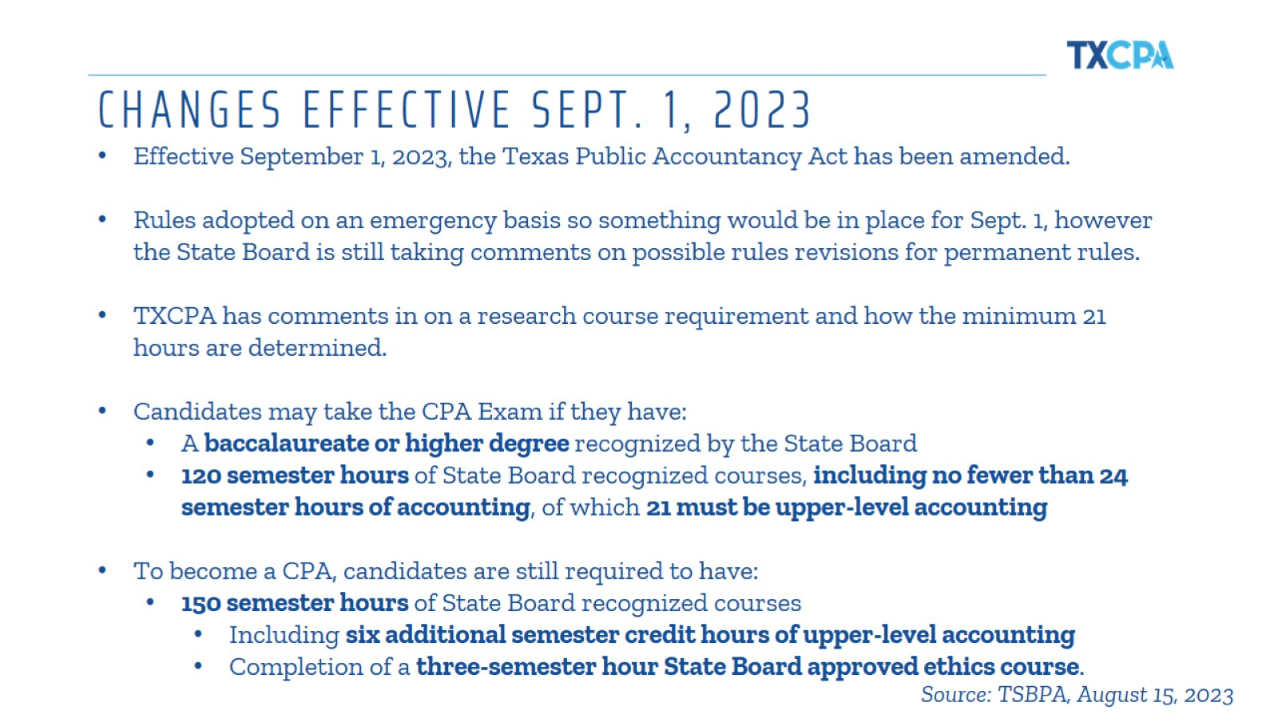
CHANGES EFFECTIVE SEPT. 1, 2023
Notes:
So, if you’re close to taking advantage of this change, here are some of rules in place as of now. These are still being fine tuned, so we encourage you to check with TXCPA and TSBPA often for any changes until these are finalized.
Candidates may take the CPA Exam if they have:
A baccalaureate or higher degree recognized by the State Board
120 semester hours of State Board recognized courses, including no fewer than 24 semester hours of accounting, of which 21 must be upper-level accounting
To become a CPA, candidates are still required to have:
150 semester hours of State Board recognized courses
Including six additional semester credit hours of upper-level accounting
Completion of a three-semester hour State Board approved ethics course.

Slide 15
MORE DETAILS FROM THE STATE BOARD
Notes:
This site includes more details about the courses needed and the timing under the current rules.

Slide 17
MEET THE DEMAND FOR RESKILLING
Notes:
Overall, there is a high demand for reskilling and growing your skill. Since the CPA profession is constantly evolving, it is imperative we never stop learning. In fact, CPAs are required to meet education requirements as part of our license renewal process.
When you look at this list of skills, you might not immediately think they are accounting or business related or that they are skills beneficial in the field. But creativity, technology, leadership, resilience and critical thinking are all important and necessary as a CPA and something you should consider growing.
I’d encourage you to broaden your scope and take advantage of any opportunities you find to add these to your list of talents.
[Provide an example when you’ve used “creative thinking or resilience” in your job]

Slide 18
BE AHEAD OF THE GAME
Notes:
In addition to telling you more about why the CPA credential is so valuable, I want to also spend a little time giving you some insight into the needs of the marketplace so you can be thinking about special skills you may want to add to your resume as you enter the CPA workforce.
You see on the slide a list of in-demand technology skills for recent grads, according to the 2024 Robert Half Salary Guide.
I’d argue that technology skills became even more critical in recent months with more companies moving to remote work arrangements in response to COVID-19. Adding technology training to your plan is definitely worthwhile when you’re looking for ways to differentiate yourself in the marketplace.
[insert any specializations/additional credentials you may have and how they have benefited you]

Slide 20
CPA EVOLUTION
Notes:
A new CPA Exam will launch in just a few months.
The initiative behind this new exam is CPA Evolution
CPA Evolution was developed by AICPA and NASBA to ensure the CPA license is responsive, adaptive and flexible for the business of the future.
The work done on this initiative has led to this new licensure model that you see here.
This will still lead to one CPA license, but it reflects reality of practice and allows us to be more adaptive and flexible with core learning and specialized tracks.
Work is being done now on any rule changes needed and resource development in preparation for the launch of a new CPA Exam.

Slide 21
HOW WILL THE EXAM CHANGE?
Notes:
Here’s how the new Exam will change:
It begins with a robust core of accounting, auditing and tax with technology woven throughout that all candidates will complete. Candidates will also select a discipline section in which to demonstrate deeper knowledge. They will need to pass the three core sections and one discipline section (max = 4 sections)
Candidates don’t have the option to pass additional disciplines – they choose only one.
All sections cover discrete content and a range of skills (including higher order)
Discipline passed will not differentiate the license granted – everyone who passes will be a CPA.

Slide 22
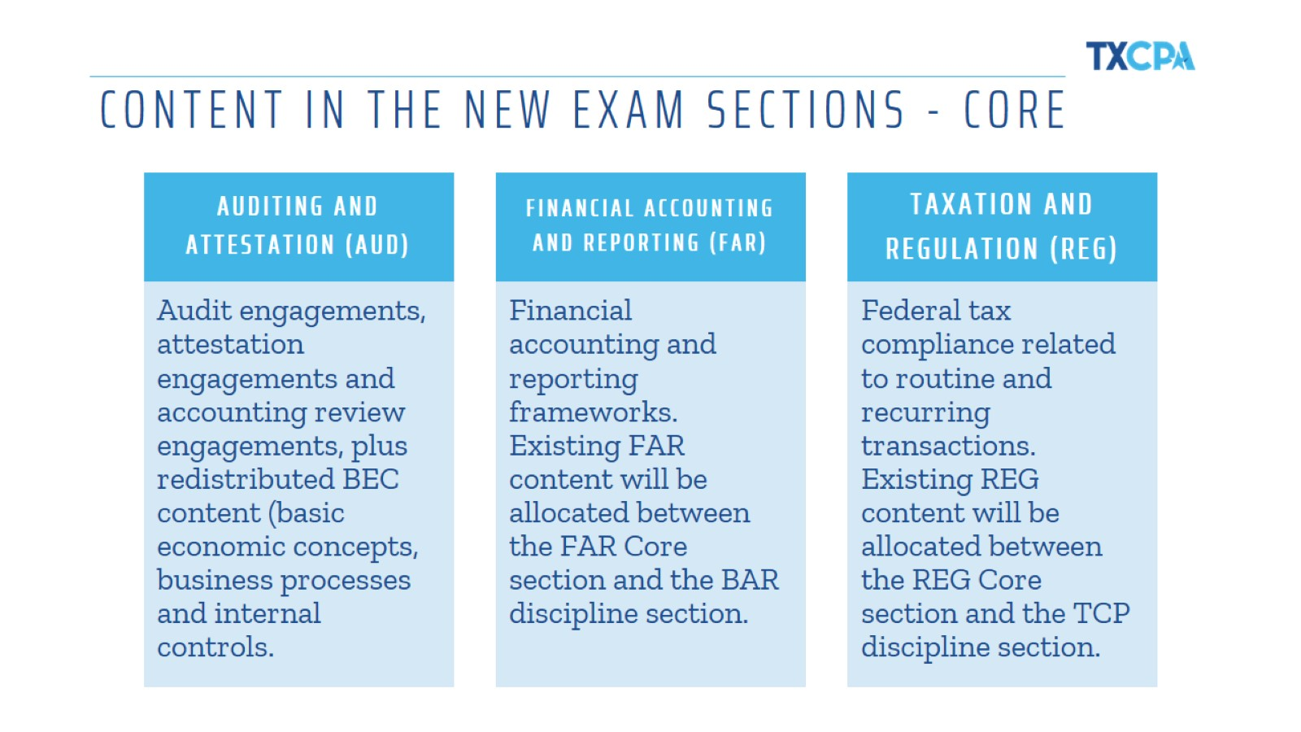
CONTENT IN THE NEW EXAM SECTIONS - CORE
Notes:
Here are just a few components covered in each of the core sections of the new exam.

Slide 23
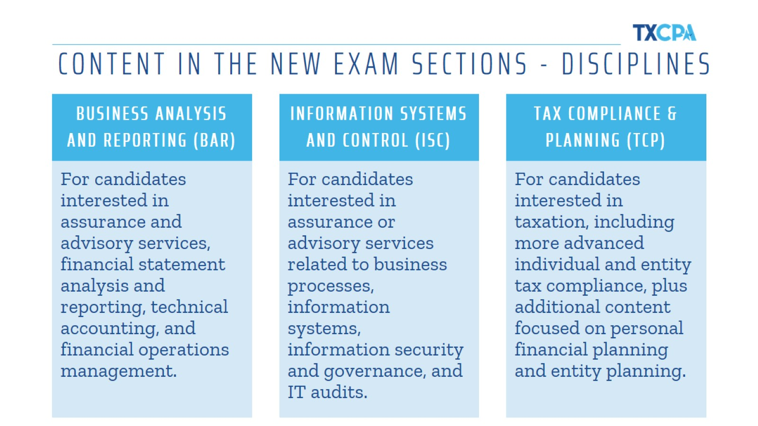
CONTENT IN THE NEW EXAM SECTIONS - DISCIPLINES
Notes:
And this gives you a little insight into each of the disciplines.
BUSINESS ANALYSIS AND REPORTING (BAR)
For candidates interested in assurance and advisory services, financial statement analysis and reporting, technical accounting, and financial operations management.
INFORMATION SYSTEMS AND CONTROL (ISC)
For candidates interested in assurance or advisory services related to business processes, information systems, information security and governance, and IT audits.
TAX COMPLIANCE & PLANNING (TCP)
For candidates interested in taxation, including more advanced individual and entity tax compliance, plus additional content focused on personal financial planning and entity planning.

Slide 24
CPA EXAM BLUEPRINTS
Notes:
AICPA has provided CPA Exam Blueprints to assist with Exam prep for the new model. You can access those at the link or QR code seen here.
These blueprints will give you samples of what you may be asked during the Exam.

Slide 25
CPA EXAM TRANSITION POLICY
Notes:
For those who have already started the exam process, there is a transition policy in place for completing the exam sections under the new model.

Slide 26
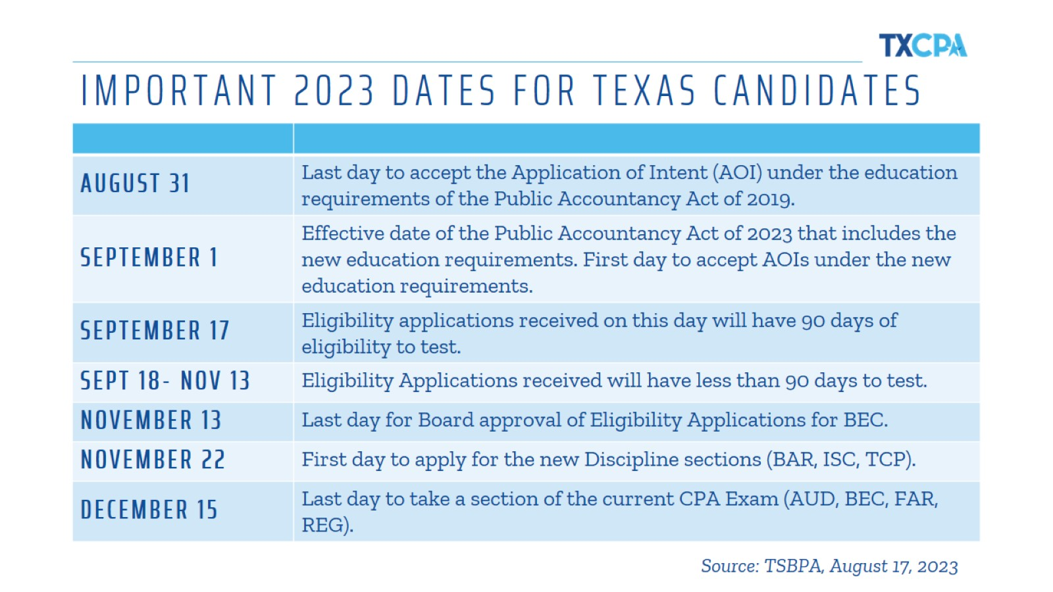
IMPORTANT 2023 DATES FOR TEXAS CANDIDATES
Notes:
We have some important deadlines coming up in Texas for those who meet the new 120 hour threshold and want to go ahead and take a section of the existing exam before it changes in January, as well as for those who want to apply for one of the new discipline sections.

Slide 27
2024 SCORE RELEASE DATES
Notes:
The Exam changes will also impact score release dates. You see here the test date windows and corresponding score reports for 2024.
So if you’re planning to test soon, these will be helpful for understanding how to schedule each section.

Slide 28
NOTICE TO SCHEDULE IN TEXAS
Notes:
Just a couple of other miscellaneous but important notes for those about to sit for the exam:
Texas is the only state with a 90-day Notice to Schedule window. All others offer more, some 12 months.
Limited Prometric testing locations, changes in the exam, and 120 to sit legislation make it critical to allow students to plan and secure a testing spot sooner.
TXCPA has been discussing the Texas requirement with TSBPA to understand the current situation and any proposed changes.
We’re pleased to share that TSBPA just passed a rule to move from 90 to 180 days for Notice to Schedule, and that goes into effect in January 2024.

Slide 29
EXPIRATION OF EXAM SECTIONS
Notes:
Additionally, TXCPA and others advocated for a change to the expiration window for exam sections.
Currently, you have 18 months from passing the first section of the exam to passing all four sections. If you don’t finish in that 18-month window, your passed sections will expire and you’ll have to take those again. That’s time and money you’ll have to spend again.
NASBA recommended an extension to 30 months based on feedback they received. Each jurisdiction has to approve this change, and we’re grateful that TSBPA has already done that and it goes into effect January 1.

Slide 30
CREDIT RELIEF INITIATIVE (CRI)
Notes:
NASBA is also looking to assist candidates who lost exam section credit during the pandemic. You can see it is estimated to be about 18,000 individuals, almost 2,000 here in Texas.
This will surely be welcome relief for those candidates who may have decided to leave the path to the CPA. We’re hoping to have an opportunity to help them along the way.

Slide 31
Notes:
I’ve shared a lot of information about the profession and resources available to you. I would keep this handy as you navigate your way to becoming a CPA in Texas.
Please remember you have the support of TXCPA and our committed volunteers here in the local chapter and across the state to help however we can.

Slide 33
FREE STUDENT MEMBERSHIP
Notes:
Now let’s talk quickly about TXCPA – your professional home now and as you move throughout your career.
We are a membership community of 28,000 working together every day to protect and promote the credential you’re working so hard to earn.
We’re here to support our members as they support their clients and employers.
And, most importantly, we’re behind our members advocating on their behalf.
Doing this together as a community of 28,000 has far greater results than we can achieve on our own as individual Texas CPAs.
We have a rich 100+ year history, and we are focused on a bright future.
The students here represent that future, and we want you to know how much we support you and want you to succeed.

Slide 34
Notes:
When you join TXCPA as a FREE student member, you have access to a variety of benefits, including membership in your local TXCPA chapter. You also gain access to:
Scholarship opportunities with TXCPA and local chapters
Leadership training opportunities with chapter and state
CPA Exam prep courses discounts
TXCPA Career Center and access to internship postings
TXCPA Exchange, our members-only online forum for questions, knowledge sharing and opportunities to connect
Searchable member directory
TXCPA’s member communications keeping you up-to-date
All of these benefits are designed to help you connect and be engaged in your future profession – giving you a jumpstart on the competition!

Slide 35
Notes:
And finally, the TXCPA 2023-24 Employer Guide is now available. This is a powerful resource that helps students explore career options, learn about organizations that employ CPAs across the state and assist them on their journey toward a successful career as a licensed CPA.
Inside, you will find helpful information on the CPA license, steps to becoming a CPA, TXCPA scholarships and resources, and a directory of Texas employers that hire top-tier talent.
Check it out online today!

Slide 36
Notes:
We’re always sharing and adding new information for future and current CPAs on our social media channels.
Please connect with us to stay informed on all things CPA and Texas. We’re on all of these platforms you see here.

Slide 37
Notes:
I know this was a great deal of information but I am here to answer any questions you may have.

Slide 38
THANK YOU!
Speaker Name | Title
Presentation Location
Presentation Date
Notes:
If a question pops in your head that didn’t get asked today, please don’t hesitate to reach out to [insert your contact information, or TX.cpa, or chapter representative].

