Slide 1

STRATEGIC PLAN UPDATE

Slide 2
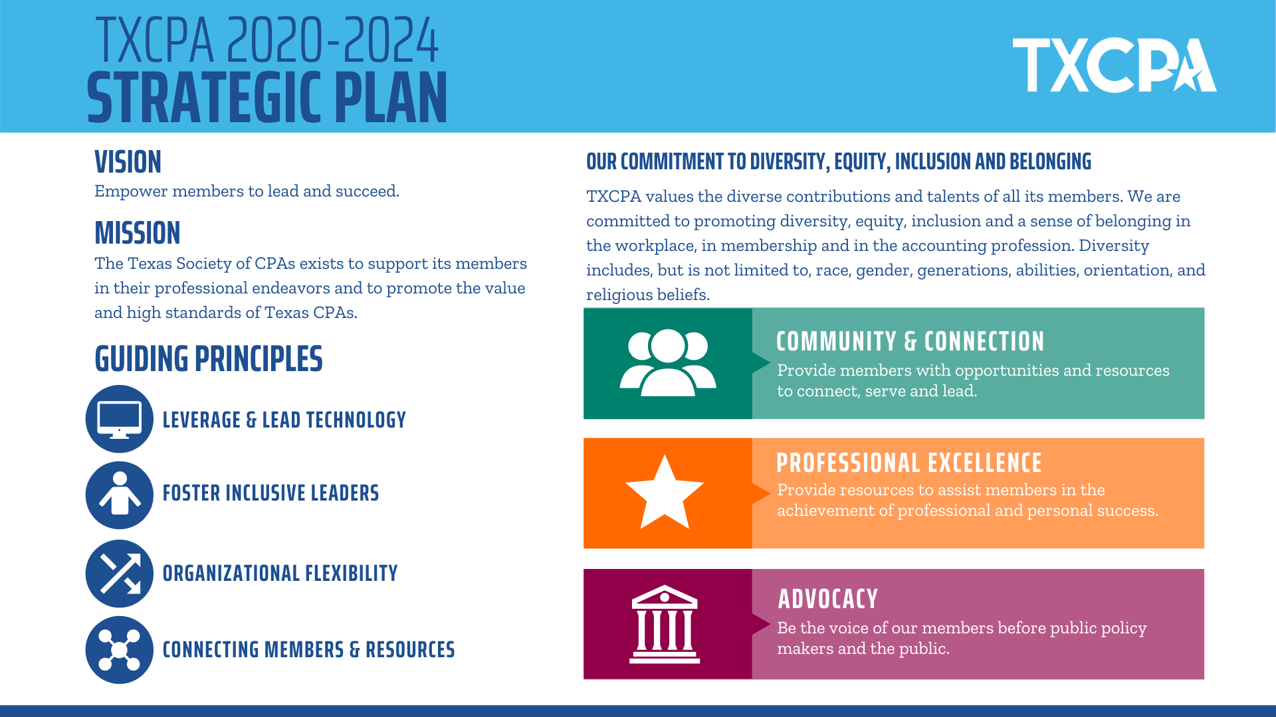

Slide 3
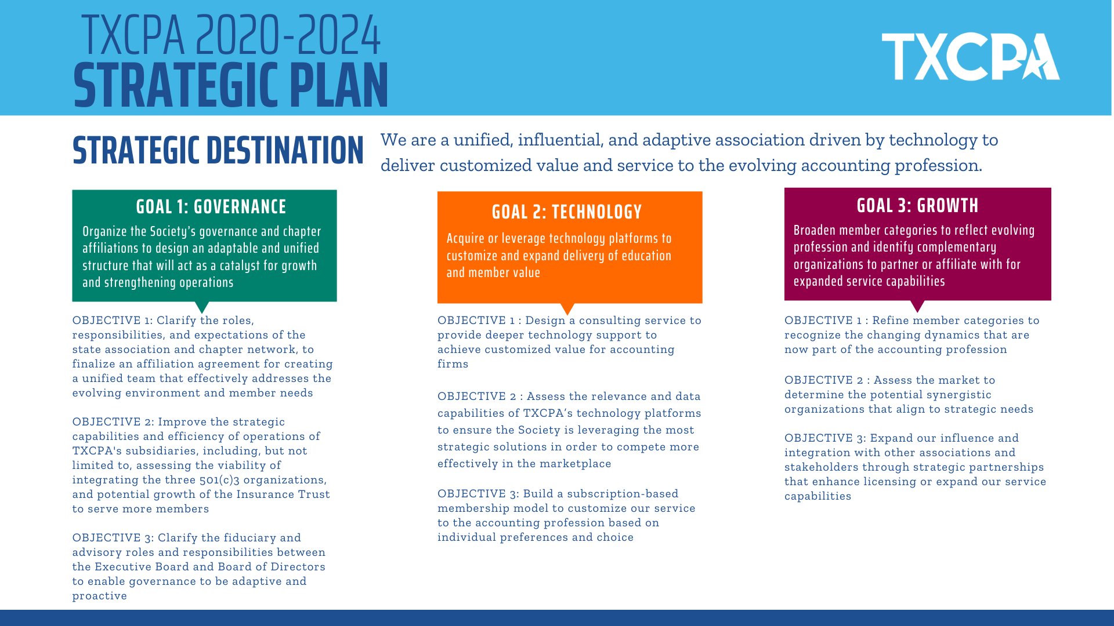

Slide 4
GOAL 1: GOVERNANCE
GOAL ONE - Organize the Society’s governance and chapter affiliations to design an adaptable and unified structure that will act as a catalyst for growth and strengthening operations
Objective 1 – Clarify the roles, responsibilities and expectations of the State Association and Chapter Network, to finalize an affiliation agreement for creating a unified team that effectively addresses the evolving environment and member needs.
Objective 2: Improve the strategic capabilities and efficiency of operations through assessing the viability of integrating the three 501 c3 subsidiaries and growing our Insurance Trust revenue by serving more members.
Objective 3: Clarify the fiduciary and advisory roles and responsibilities between the Executive Board and Board of Directors to enable governance to be adaptive and proactive.

Slide 5
GOAL 2: TECHNOLOGY
GOAL TWO - Acquire or leverage technology platforms to customize and expand the delivery of education and member value.
Objective 1: Design a consulting service to provide deeper technology support to achieve customized value for accounting firms.
Objective 2: Assess our technology platforms and their relevance and data capability, to ensure we are leveraging the most strategic solutions that provide the ability to compete more effectively.
Objective 3: Build a subscription-based membership model to customize our service to the accounting profession based on individual preferences and choice.

Slide 6
GOAL 3: GROWTH
GOAL THREE - Broaden member categories to reflect evolving profession and identify complimentary organizations to partner or affiliate with for expanded service capabilities
Objective 1: Refine member categories to recognize the changing dynamics that are now part of the accounting profession.
Objective 2: Assess the market to determine the potential synergistic organizations that align to strategic needs.
Objective 3: Expand our influence and integration with other associations and stakeholders through strategic partnerships that enhance licensing or expand our service capabilities.

Slide 7



PILLARS IN ACTION AT THE CHAPTER LEVEL
Pipeline initiatives, membership, community service, volunteers
CPE, communications
2021 legislative session, key person, legislator visits

