Slide 1


MONEY MANAGEMENT 101:
A GUIDE TO FINANCIAL BASICS FOR STUDENTS
{NAME}
{COMPANY}
{DATE}

Slide 2


Slide 3

YOUR PAYCHECK AND SAVINGS

Slide 4

BE A SAVVY SHOPPER

Slide 5


Slide 6

UNDERSTANDING TAXES

Slide 7
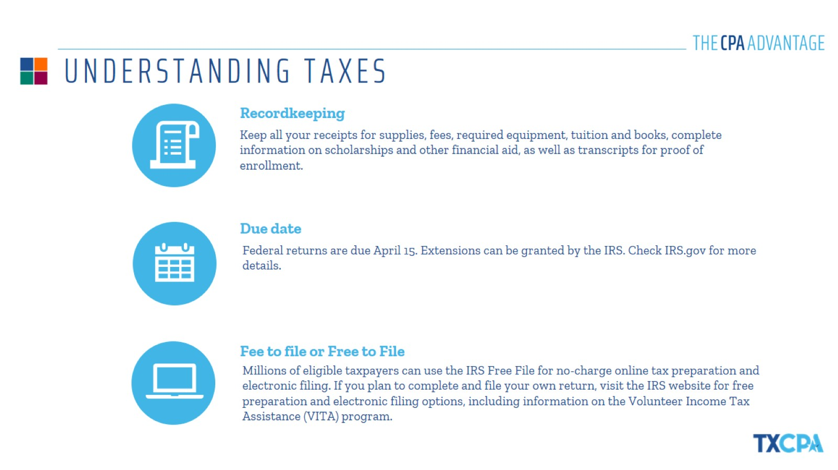
UNDERSTANDING TAXES

Slide 8


Slide 9

WHAT IS BUDGETING?

Slide 10
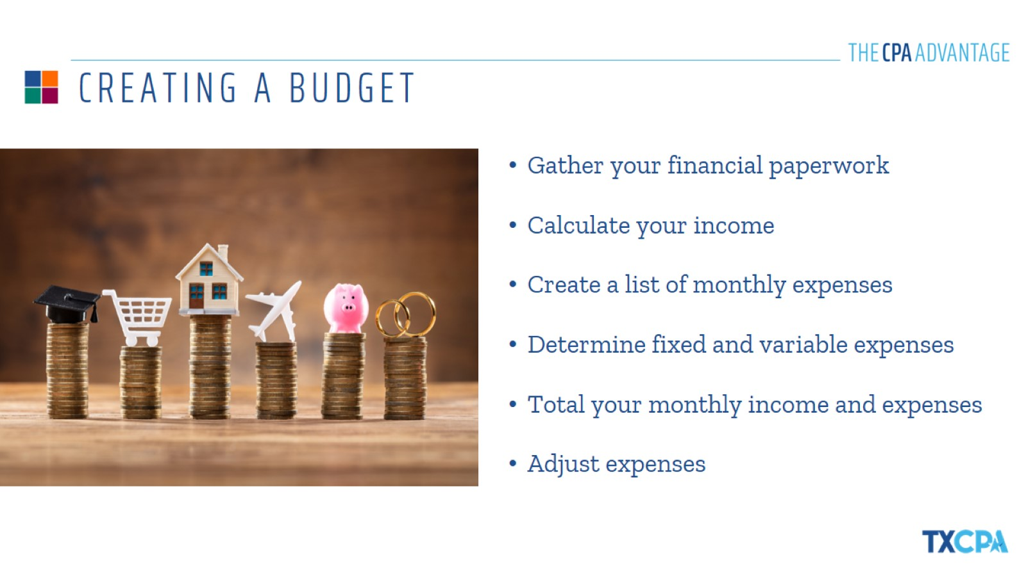
CREATING A BUDGET

Slide 11

KEEPING YOUR BUDGET ON TRACK

Slide 12


Slide 13
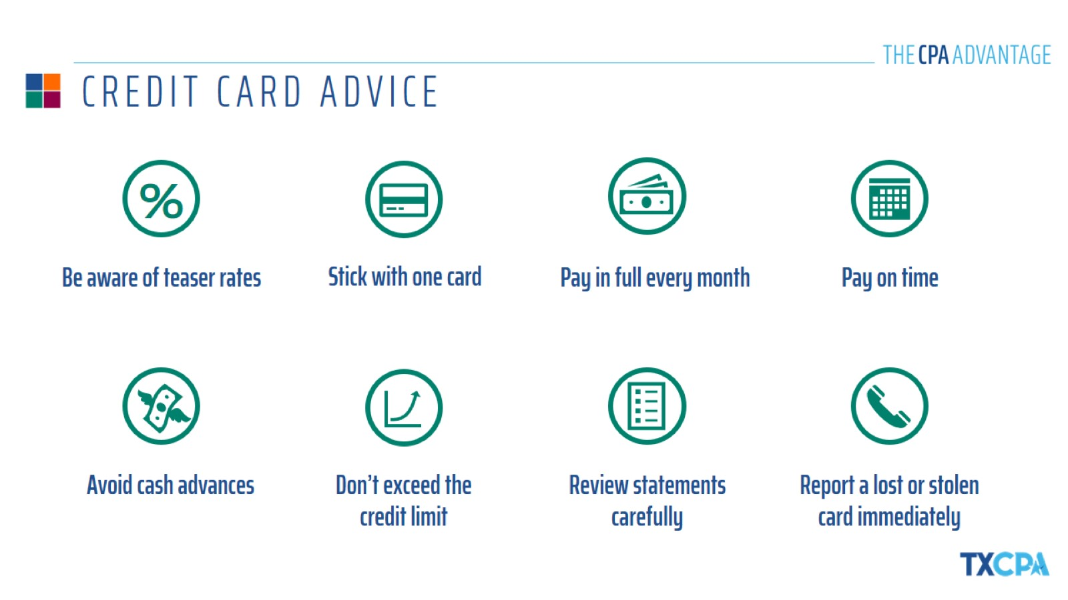
CREDIT CARD ADVICE

Slide 14
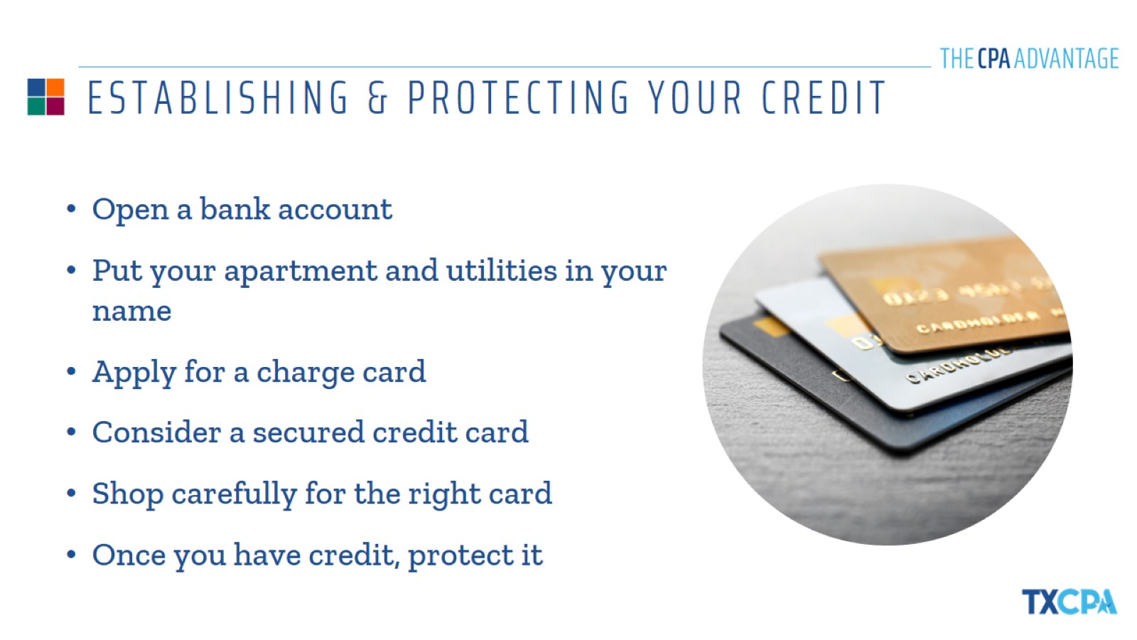
ESTABLISHING & PROTECTING YOUR CREDIT

Slide 15


Slide 16

TYPES OF ACCOUNTS

Slide 17
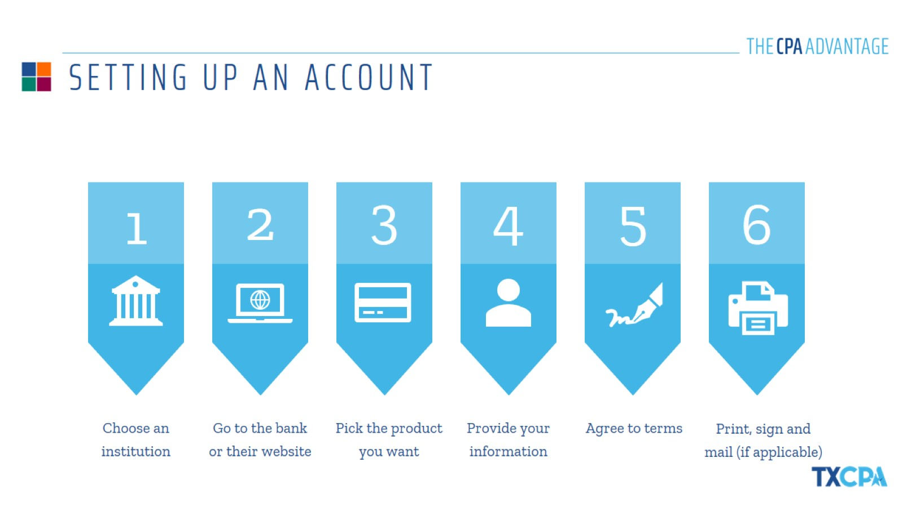
SETTING UP AN ACCOUNT

Slide 18
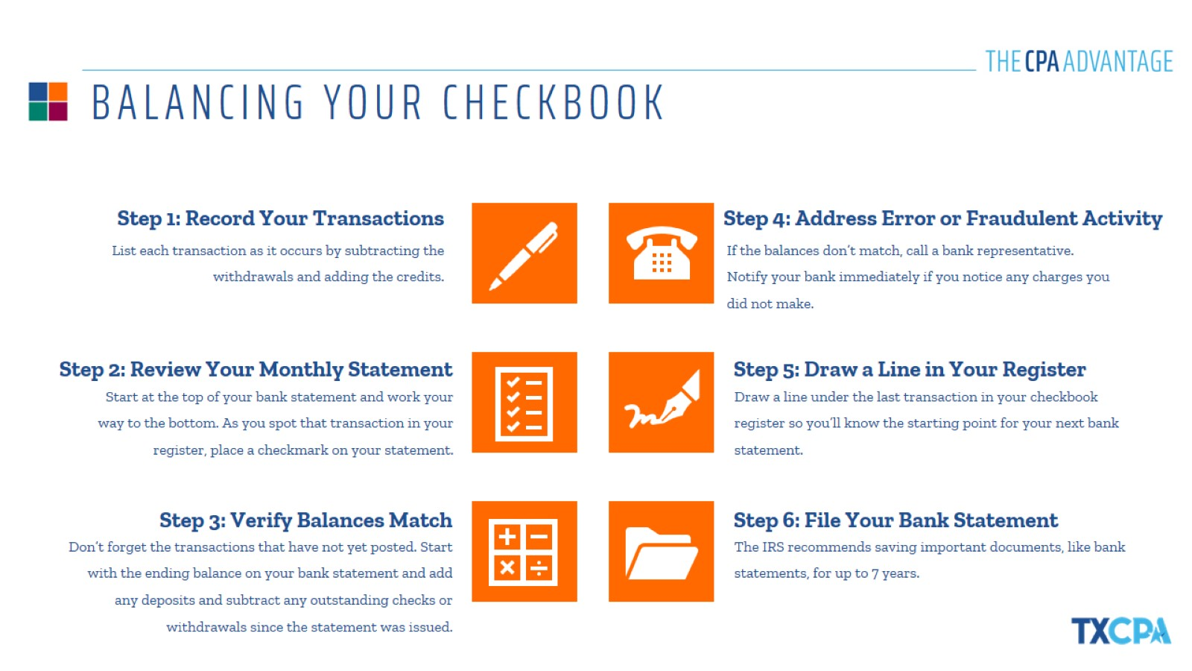
BALANCING YOUR CHECKBOOK

Slide 19


Slide 20
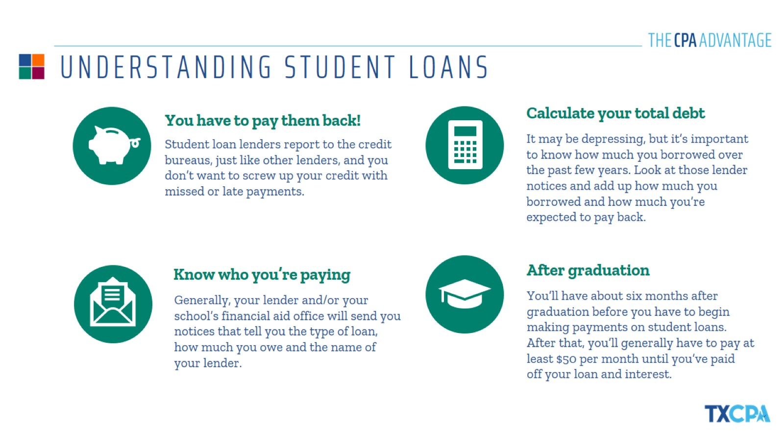
UNDERSTANDING STUDENT LOANS

Slide 21

STRATEGIES TO PAY OFF STUDENT LOANS

Slide 22


Slide 23
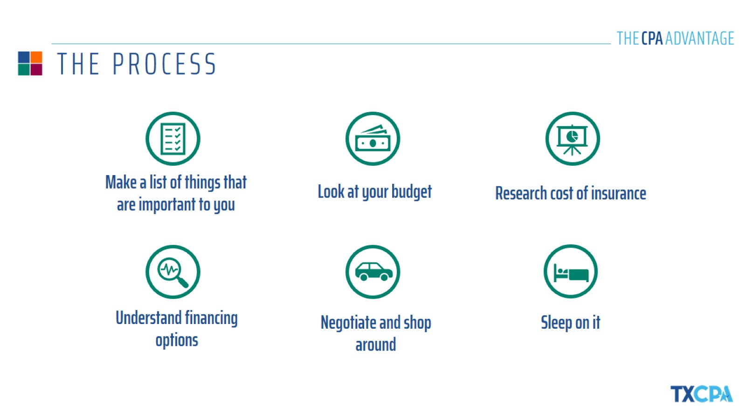
THE PROCESS

Slide 24

ALL ABOUT AUTO INSURANCE

Slide 25


Slide 26
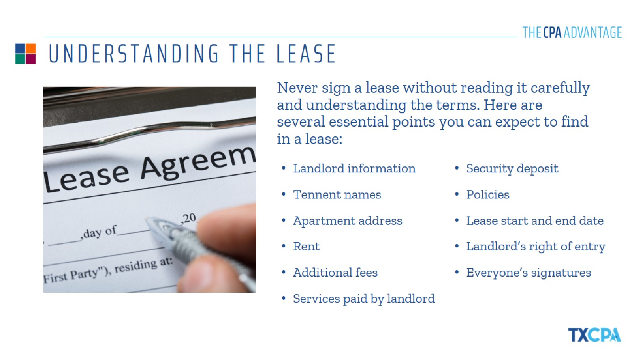
UNDERSTANDING THE LEASE

Slide 27
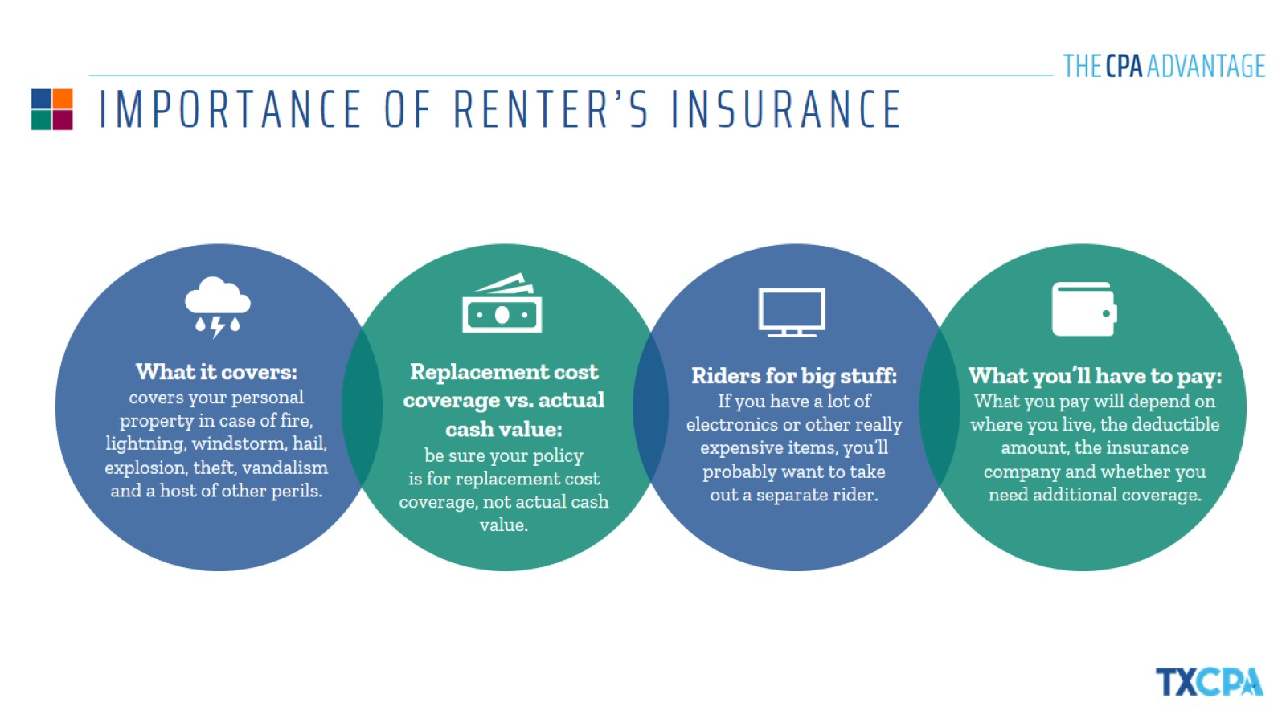
IMPORTANCE OF RENTER’S INSURANCE

Slide 28
THANK YOU!
{NAME}
{COMPANY}
{DATE}

