Slide 1
INTERNET SAFETY FOR SENIORS:
A GUIDE TO PROTECTING YOURSELF ONLINE
{NAME}
{COMPANY}
{DATE}

Slide 3
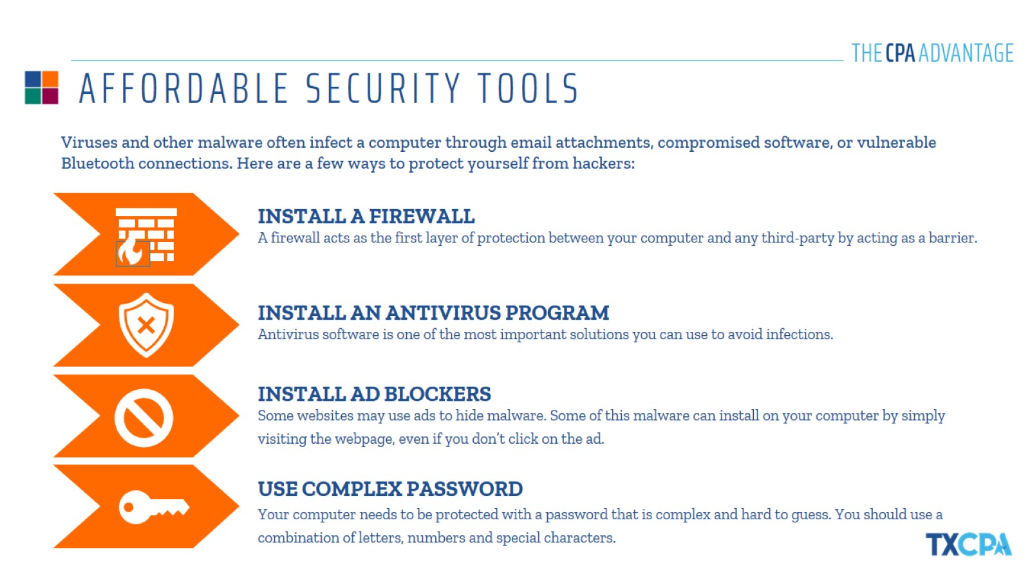
AFFORDABLE SECURITY TOOLS

Slide 5
EMAIL SCAMS

Slide 6
TAX AND BANKING SCAMS

Slide 7
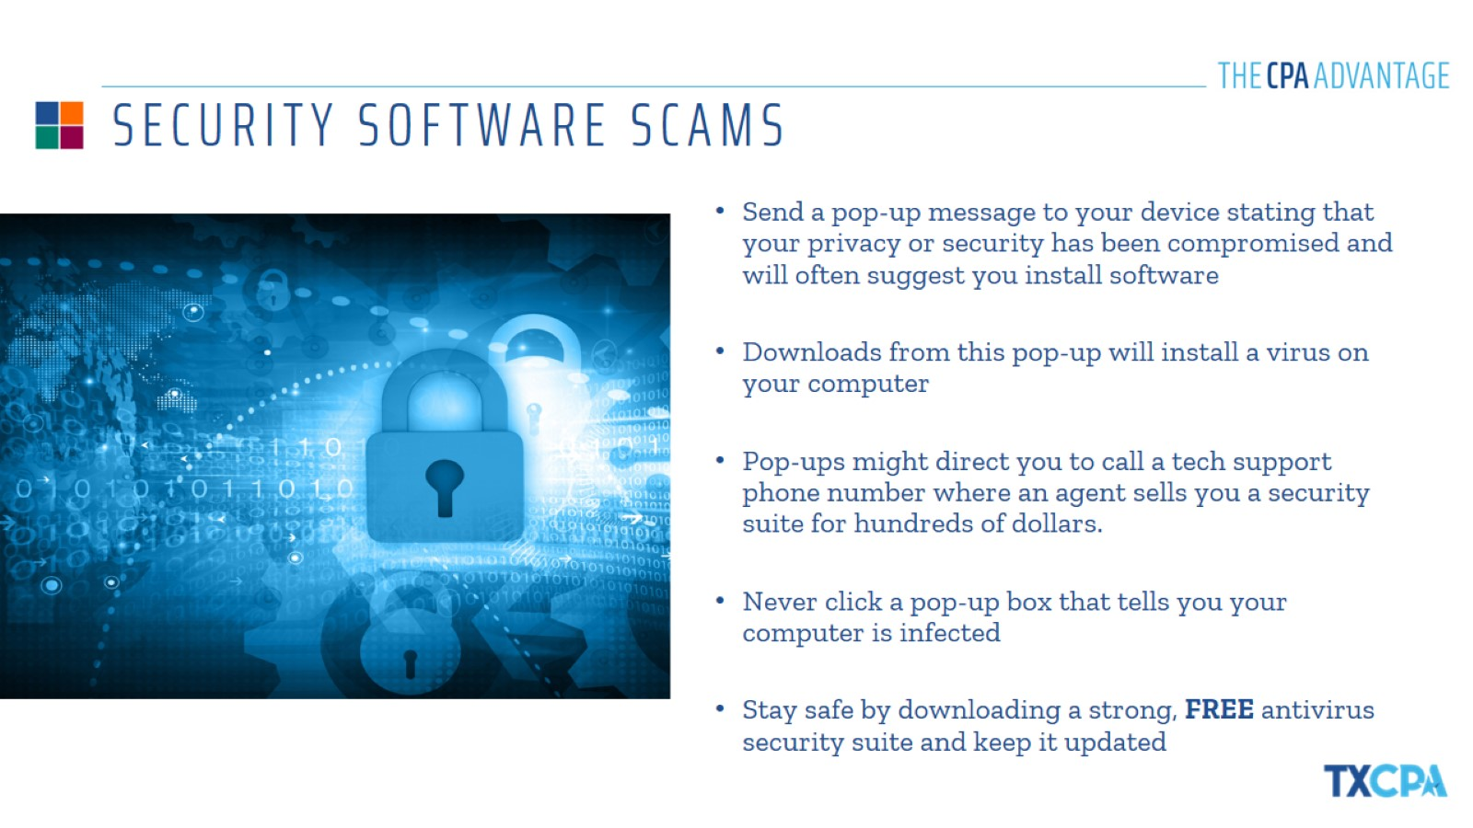
SECURITY SOFTWARE SCAMS

Slide 8
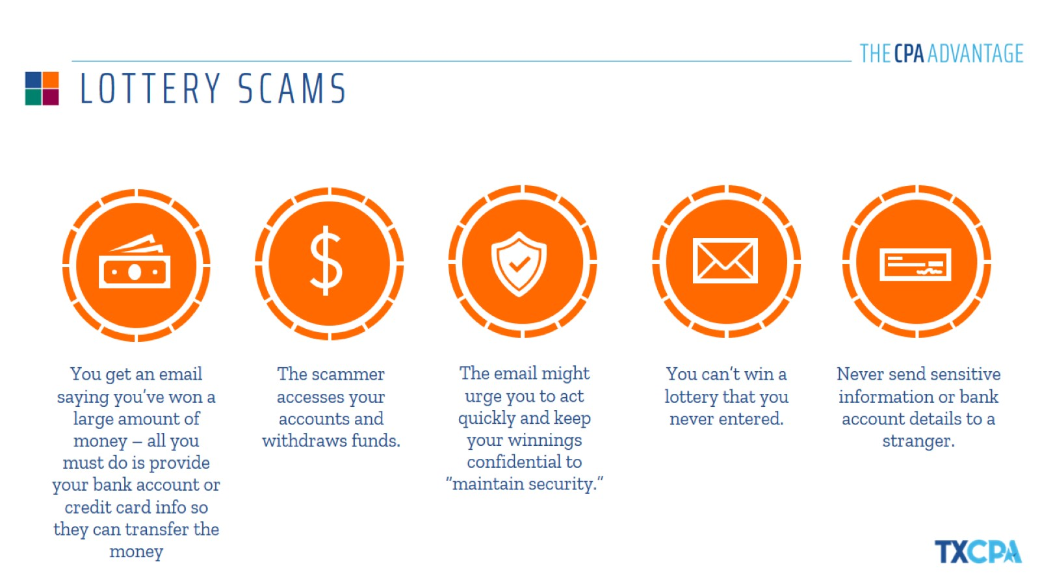
LOTTERY SCAMS

Slide 9
ROMANCE/CATFISHING SCAMS

Slide 10
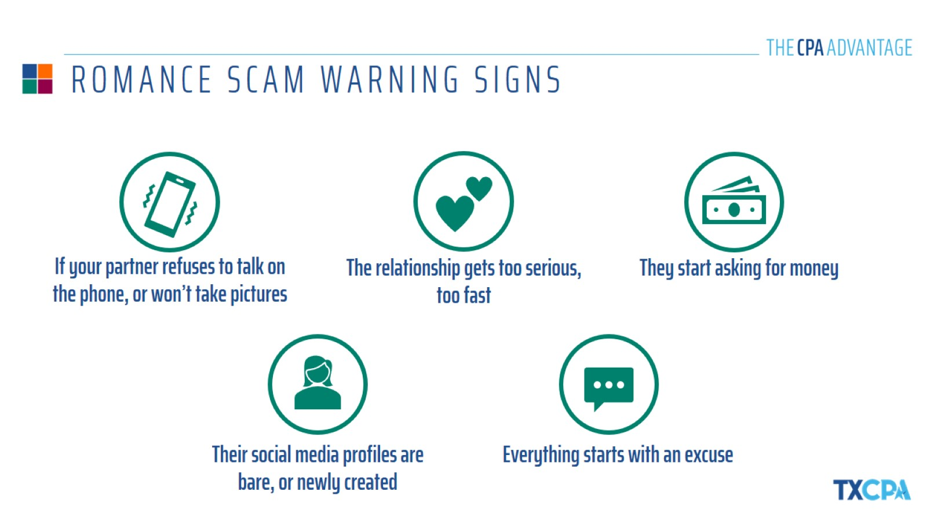
ROMANCE SCAM WARNING SIGNS

Slide 11
GRANDPARENT SCAMS

Slide 13
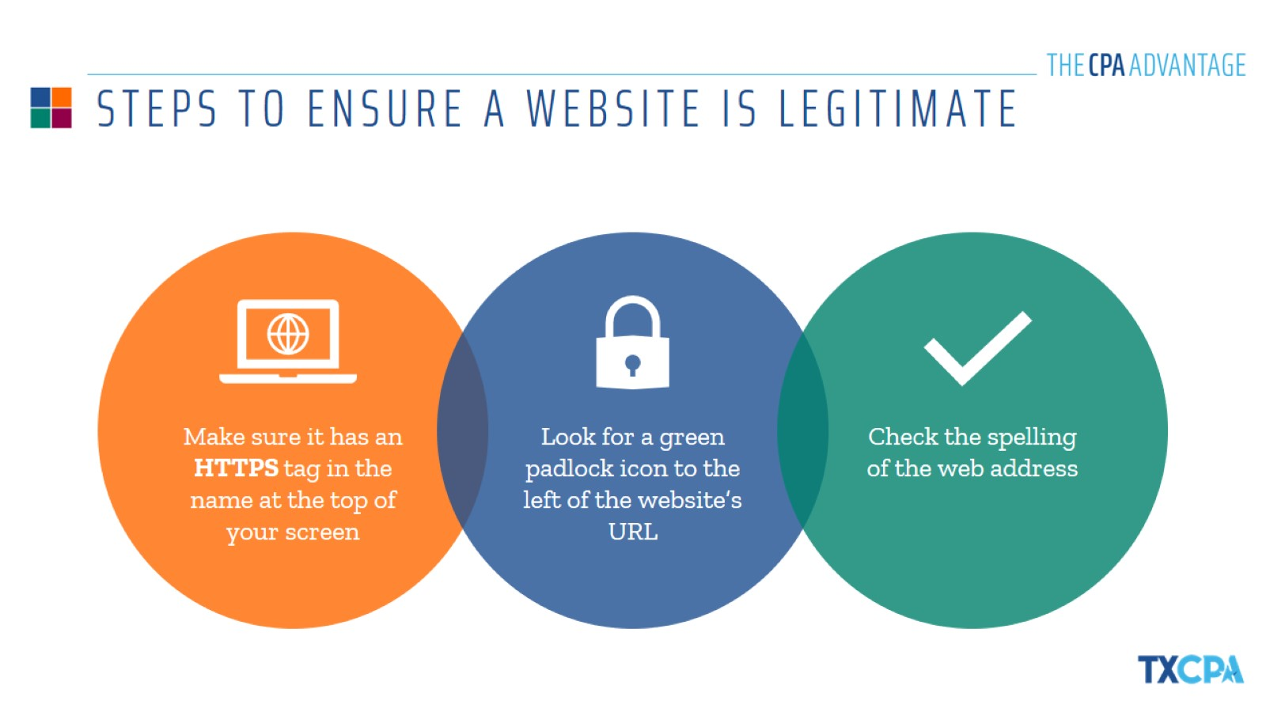
STEPS TO ENSURE A WEBSITE IS LEGITIMATE

Slide 15
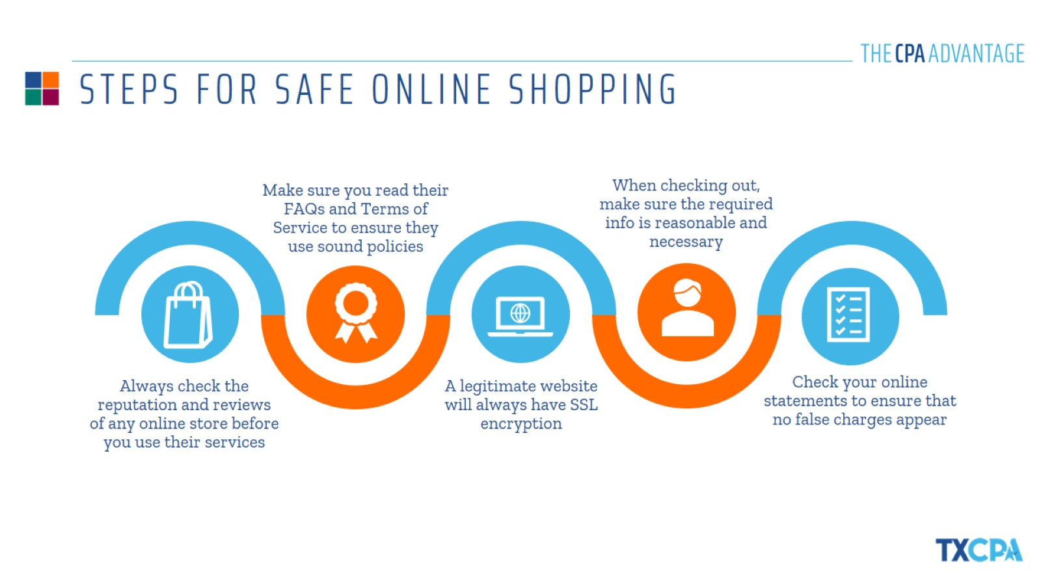
STEPS FOR SAFE ONLINE SHOPPING

Slide 17
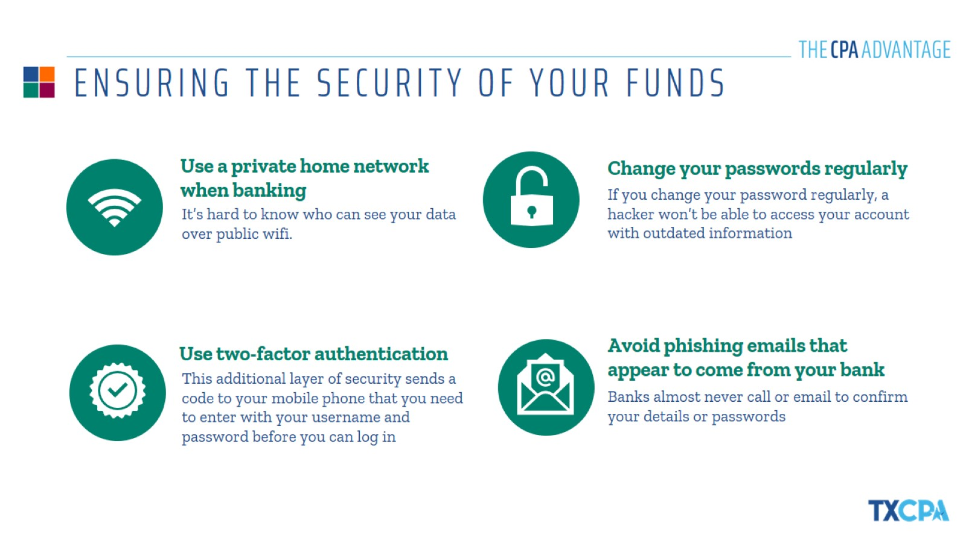
ENSURING THE SECURITY OF YOUR FUNDS

Slide 19
HOW TO PROTECT YOUR IDENTITY

Slide 21
TIPS TO STAY SAFE ON SOCIAL MEDIA

Slide 23
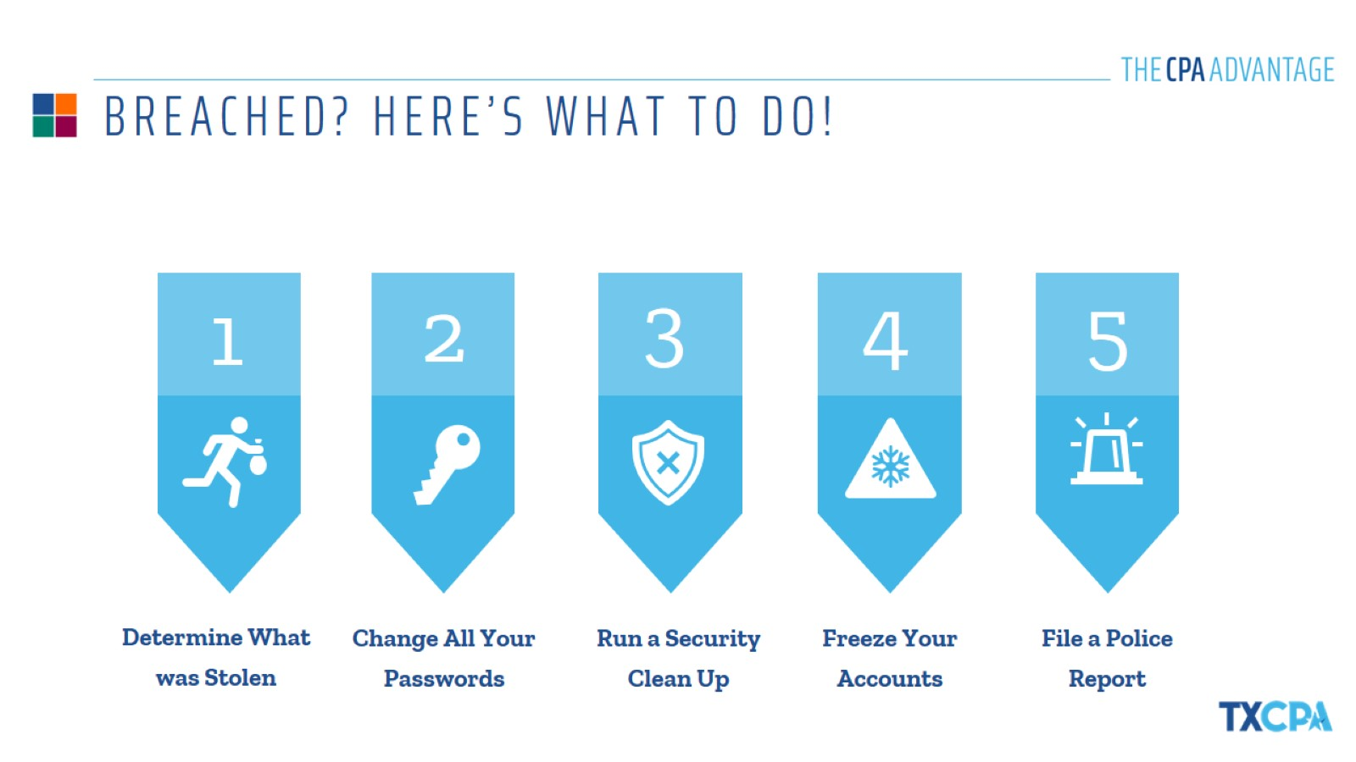
BREACHED? HERE’S WHAT TO DO!

Slide 25
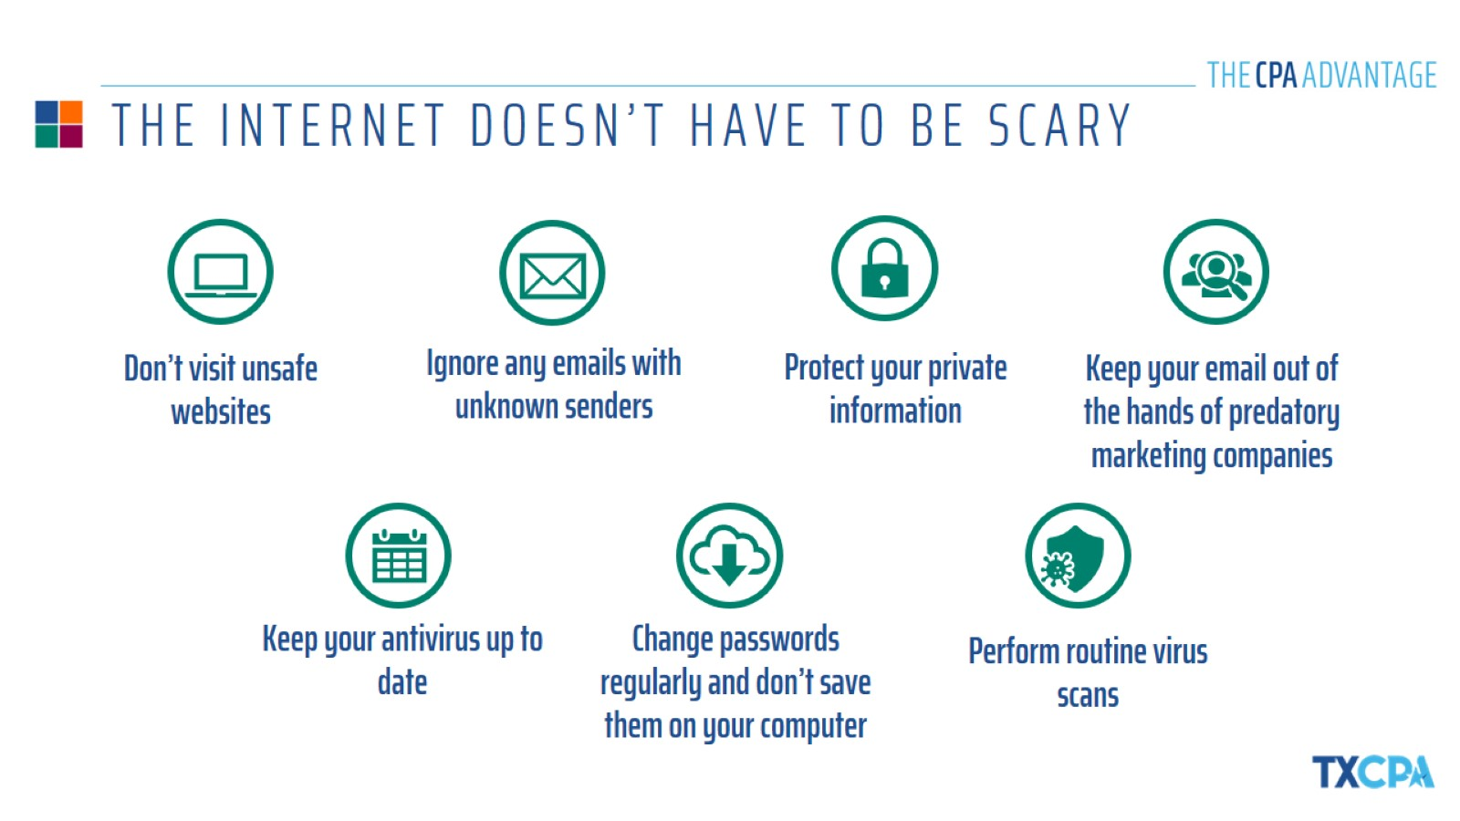
THE INTERNET DOESN’T HAVE TO BE SCARY

Slide 26
THANK YOU!
{NAME}
{COMPANY}
{DATE}

