Slide 1
MONEY MANAGEMENT 101:
A GUIDE TO FINANCIAL BASICS
{NAME}
{COMPANY}
{DATE}

Slide 3
YOUR PAYCHECK AND SAVINGS

Slide 4
BE A SAVVY SHOPPER

Slide 6
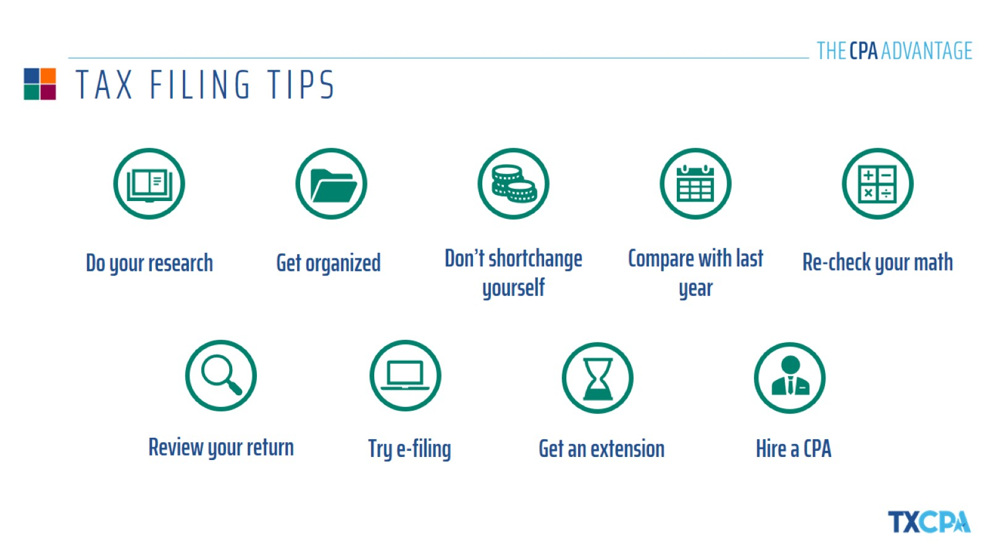
TAX FILING TIPS

Slide 7
THE MOST COMMONLY OVERLOOKED DEDUCTIONS

Slide 9
WHAT IS BUDGETING?

Slide 10
CREATING A BUDGET

Slide 11
KEEPING YOUR BUDGET ON TRACK

Slide 13
CREDIT CARD ADVICE

Slide 14
ESTABLISHING & PROTECTING YOUR CREDIT

Slide 16
TYPES OF ACCOUNTS

Slide 17
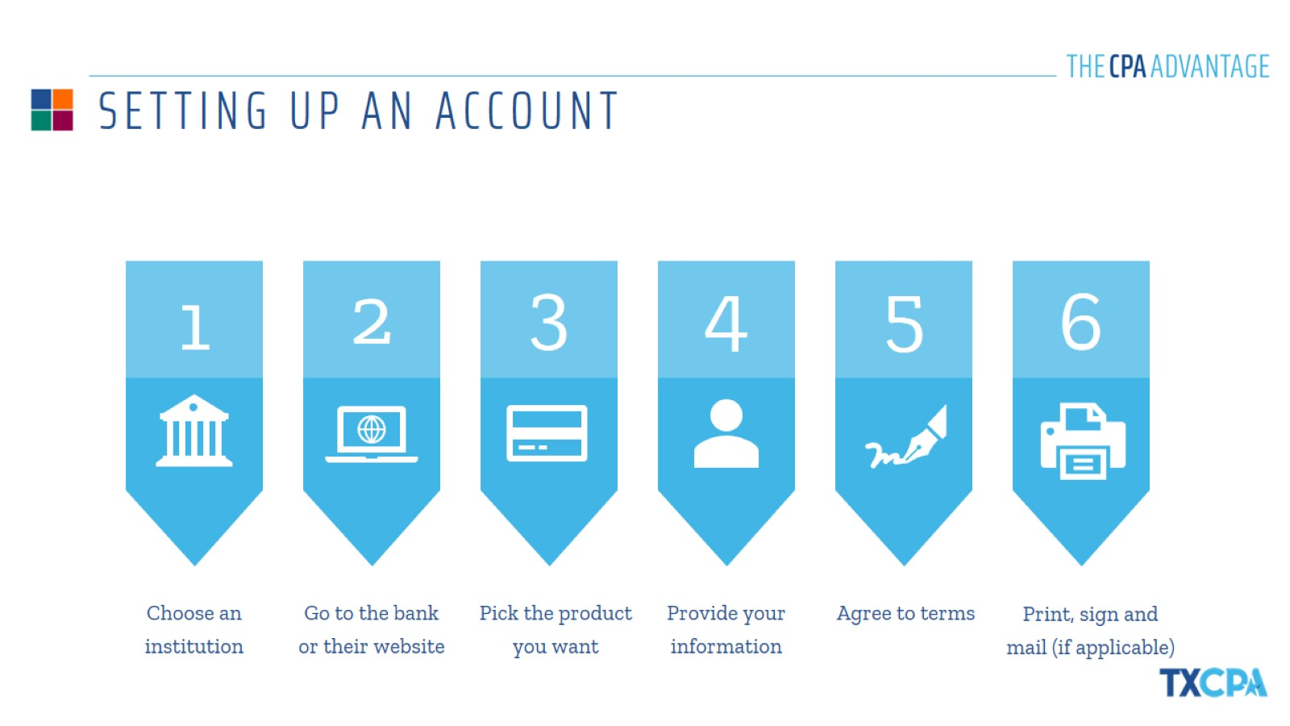
SETTING UP AN ACCOUNT

Slide 18
BALANCING YOUR CHECKBOOK

Slide 19
DIGITAL BALANCING OPTIONS

Slide 21
BUYING VS. LEASING A CAR

Slide 22
THE CAR BUYING PROCESS

Slide 23
ALL ABOUT AUTO INSURANCE

Slide 25
RENTING VS. OWNING A HOME

Slide 26
THE HOME BUYING PROCESS

Slide 27
UNDERSTANDING THE LEASE

Slide 28
THANK YOU!
{NAME}
{COMPANY}
{DATE}

